Slide 1



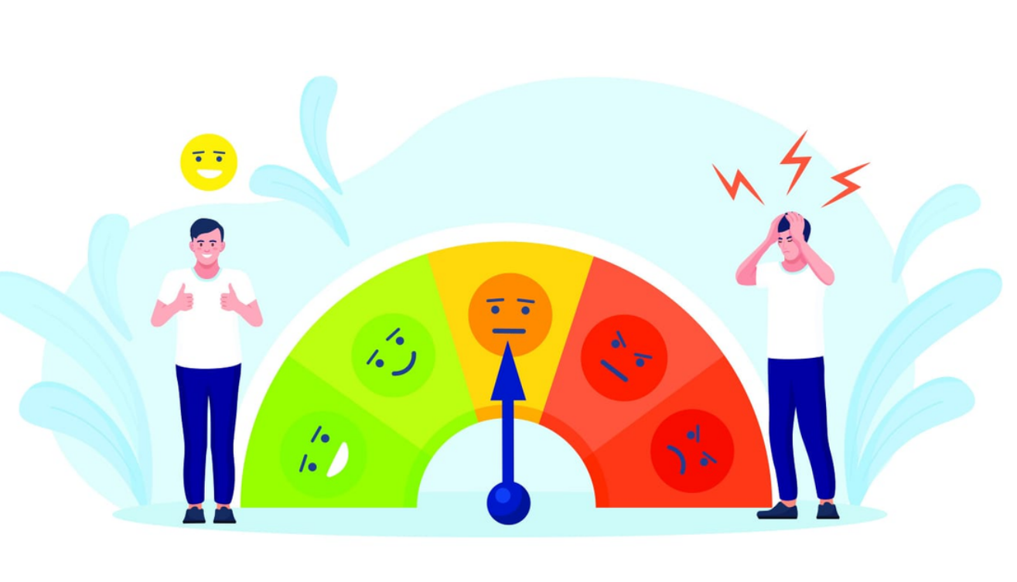
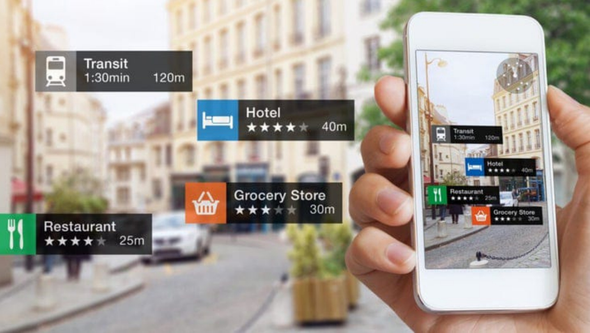
TRAVEL REVIEW SENTIMENT ANALYSIS
AIML INTEGRATED PROJECT

Slide 2








































































































TRAVEL REVIEW SENTIMENT
ANALYSIS
Project Overview
Mentored by: Mr Harendra Sir
Team Members
Ekta Mathus 25SCS1003004233
Sweta Prakash 25SCS1003004266
Jasmine 25SCS1003000852
Chander Kantiwal 25SCS1003004267
Anuraj 25SCS1003004238

Slide 3

INTRODUCTION
This project focuses on identifying whether tourist
reviews express positive, negative, or neutral opinions.
We collect review data, preprocess it by cleaning text,
removing noise, and tokenizing words, then train
machine-learning or deep-learning models to classify
sentiments accurately. The system also visualizes
trends to help tourism businesses understand
customer experiences. This project demonstrates
skills in data collection, NLP techniques, model
building, and real-world analysis.

Slide 4

What is Travel Review
Sentiment Analysis
With the rapid digitalization of the travel and tourism industry, millions of travelers post reviews every day on hotel
booking platforms, airline service portals, destination review websites, and social media. These reviews contain
valuable insights about customer satisfaction, service quality, comfort, safety, pricing, hospitality, and overall travel
experience.
However, manual reading and analysis of thousands of reviews is time-consuming, inconsistent, and inefficient. This
challenge is effectively solved using Sentiment Analysis, an advanced Natural Language Processing (NLP) technique
that automatically identifies whether a review expresses positive, negative, or neutral sentiment.
Travel Review Sentiment Analysis helps:
1. Hotels understand service quality.
2. Airlines track customer satisfaction.
3. Tourism companies improve travel packages.
4. Governments monitor tourism experience
Travelers make informed decisions based on genuine feedback.
This project aims to build an intelligent system that analyzes travel reviews using Machine Learning (ML) and NLP,
classifies them into sentiment categories, and generates meaningful insights

Slide 5

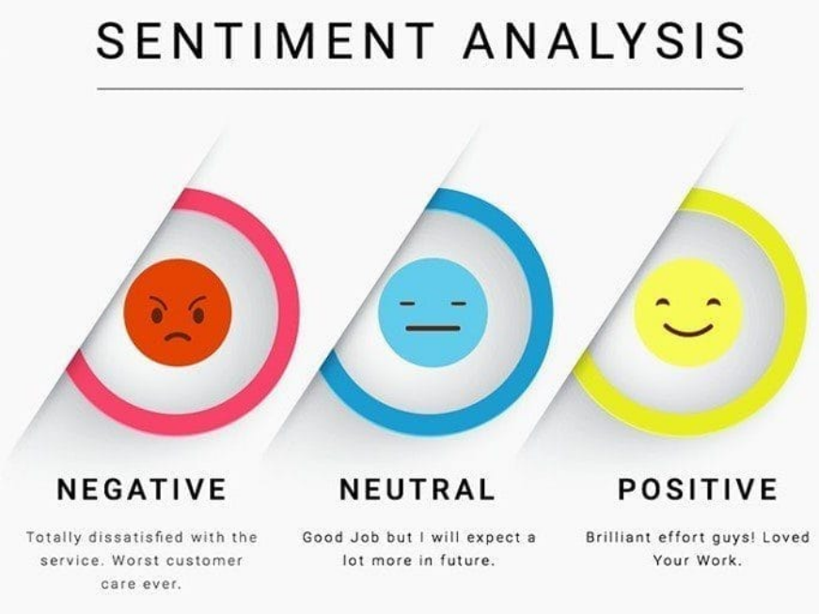
Problem Statement
In the modern tourism industry, travelers increasingly rely on online platforms such as TripAdvisor, Google Reviews, MakeMyTrip, and Airbnb to share and
read experiences. These platforms contain thousands of user-generated reviews that strongly influence travel decisions—such as selecting destinations,
booking hotels, choosing tour packages, and evaluating travel services. However, the sheer volume of reviews makes it difficult for travelers, travel agencies,
and service providers to manually interpret customer opinions and identify overall satisfaction trends.
This creates a need for an automated system that can accurately analyze these reviews and classify them as positive, negative, or neutral. Traditional
manual processing is not only time-consuming but also prone to bias and inconsistency. Businesses require quick insights to improve service quality, while
users need summarised feedback to help them make reliable decisions.
The problem is further complicated because travel reviews often contain:
Informal language
Slang, abbreviations, and emojis
Mixed sentiments in a single review
Varying writing styles across different users
Therefore, an effective solution must handle natural language complexities and deliver consistent sentiment predictions.
This project aims to build a machine learning/NLP-based sentiment analysis model that processes raw travel reviews, cleans and transforms text data,
extracts meaningful features, and classifies sentiment with high accuracy. The system should help tourism businesses monitor satisfaction levels, identify
areas needing improvement, and enhance customer experience. Similarly, travelers can benefit from overall sentiment summaries before choosing
destinations or services.

Slide 6

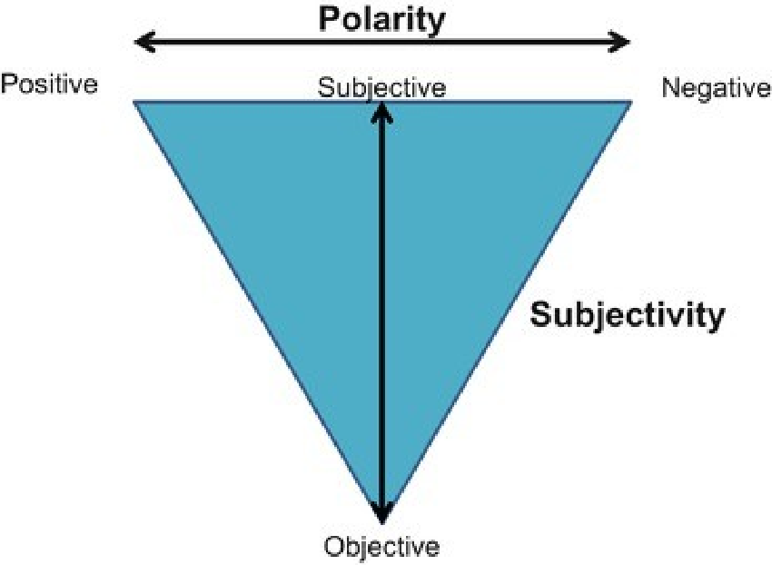
Polarity
Polarity in travel review sentiment analysis refers to
identifying whether a review expresses a positive,
negative, or neutral attitude. It involves scoring the
emotional tone of the text based on words, phrases, and
context. For example, terms like “clean rooms” or
“amazing experience” indicate positive polarity, while
“poor service” or “overpriced” signal negative polarity.
Neutral polarity appears when the review is factual
without strong emotion. This helps classify overall
traveler satisfaction and trends.

Slide 7


Preprocessing
Preprocessing is the process of preparing raw travel review text data for sentiment
analysis. Since user-generated reviews often contain noise such as misspellings,
emojis, symbols, and inconsistent formatting, preprocessing ensures that the data
becomes clean, structured, and ready for further analysis. The main goal is to
transform unstructured text into a form that machine learning models can
understand.
Steps in Preprocessing
1. Data Cleaning
2. Tokenization
Tokenization splits the sentence into individual words (tokens).
Example:
“the hotel was very clean” →[“the”, “hotel”, “was”, “very”, “clean”]
5. Handling Emojis and Slang
Travel reviews often include emojis:
😍→positive sentiment
😡→negative sentiment

Slide 8

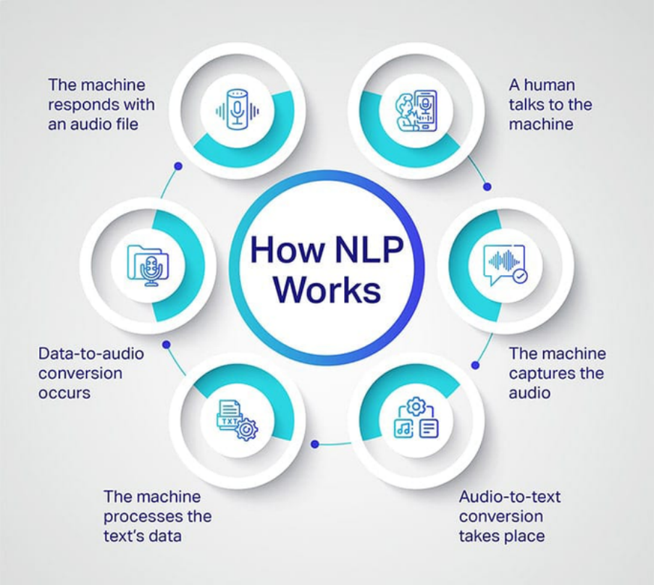
Natural Language Processing (NLP)
Its Converts raw textual reviews into structured information
that a machine learning model can understand. It includes
steps like cleaning text (removing noise, stopwords,
punctuation), normalizing words (stemming or
lemmatization), converting text into numerical features
using methods such as Bag-of-Words, TF-IDF, or word
embeddings, and finally analyzing the underlying opinions
expressed in the reviews. NLP helps the system detect
whether a travel review carries positive, negative, or neutral
sentiment, enabling better understanding of traveler
experiences and trends.

Slide 9

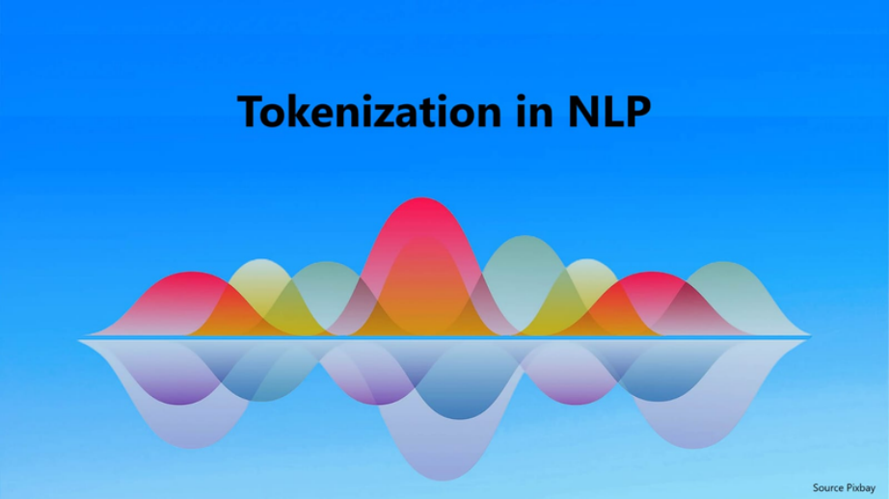
Tokenization
Tokenization is the process of breaking raw text (like travel reviews)
into smaller units called tokens. These tokens can be words,
subwords, or sentences depending on the approach. In sentiment
analysis, tokenization is crucial because models can only understand
structured
inputs,
not
continuous
text.
For
travel
reviews,
tokenization helps isolate meaningful parts such as destination
names (“Goa”, “Manali”), sentiment words (“amazing”, “worst”), and
travel-related expressions.
Common
methods
include
word
tokenization
(splitting
by
spaces/punctuation), subword tokenization (used in models like BERT
to handle rare words like “beachfront”), and sentence tokenization
for
context
understanding.
Good
tokenization
improves
model
accuracy by ensuring consistent handling of slang, emojis, and
domain-specific terms often found in travel reviews.

Slide 10

Dataset information
The project uses a dataset containing textual reviews from travelers about destinations, hotels, flights, or
tourism services. Each review is labeled with a sentiment category—typically positive, negative, or neutral. The
dataset may also include metadata such as rating, location, date, reviewer profile, and review source.
Before modeling, the text is cleaned through tokenization, stop-word removal, lowercasing, lemmatization, and
punctuation removal. The cleaned text is then converted into features using methods like Bag-of-Words, TF-
IDF, or word embeddings (Word2Vec / GloVe).
If no public dataset is used, reviews can be collected from platforms like TripAdvisor, Yelp, Google Reviews, or
Kaggle datasets focused on travel and tourism. A typical dataset contains 5,000–50,000 reviews, ensuring
sufficient balance across sentiment classes for reliable model training.

Slide 11

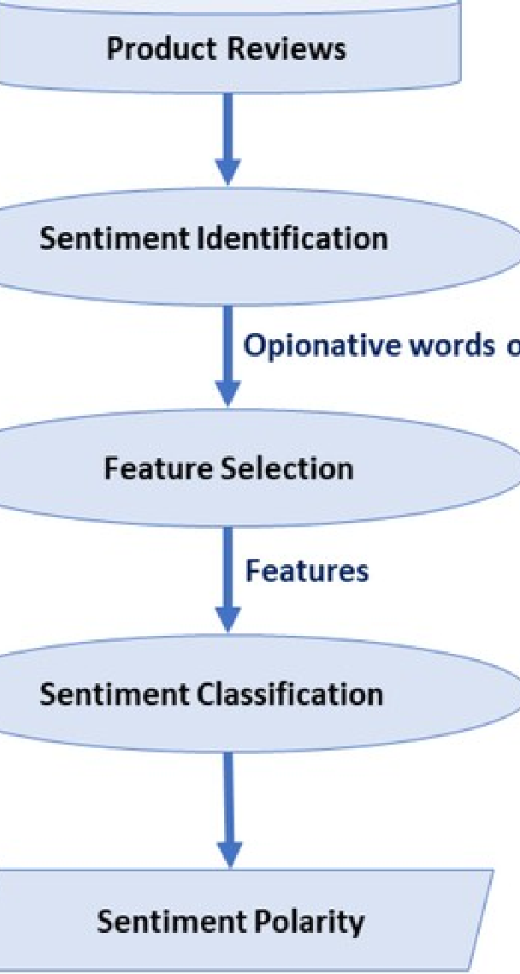
Proposed Methodology
A suitable methodology for a travel review sentiment analysis project
can follow a structured workflow. First, collect reviews from reliable
travel platforms and store them in a clean, organized dataset. Next,
preprocess the text through steps like lowercasing, removing
stopwords, punctuation, special characters, and performing
tokenization and lemmatization to standardize the language. After this,
convert the cleaned text into numerical form using techniques such as
TF-IDF or word embeddings. Then, train multiple machine-learning or
deep-learning models—such as Logistic Regression, SVM, Random
Forest, or LSTM—to classify sentiments as positive, negative, or neutral.
Evaluate the models using accuracy, precision, recall, and F1-score to
identify the best performer. Finally, deploy the chosen model through a
simple UI or dashboard that allows users to input a review and instantly
see sentiment predictions, making the system practical and user-
friendly for tourism applications.

Slide 12


Algorithm Used
Logistic Regression
Often gives strong baseline performance for
binary and multi-class sentiment tasks.
Support Vector Machine (SVM)
Handles high-dimensional text data well and
typically gives very good accuracy.
Naive Bayes (Multinomial NB)
Fast, simple, and performs well on short reviews.
Random Forest / Decision Trees
Used occasionally, but less effective than LR or
SVM for text.

Slide 13

Conclusion
The project successfully demonstrates how sentiment analysis
can be applied to travel reviews to extract meaningful insights
about tourist experiences. By preprocessing text data, applying
machine learning or deep-learning models, and evaluating their
performance, the system effectively classifies reviews into
positive, negative, or neutral sentiments. This helps tourism
businesses and platforms understand customer opinions at scale,
improve services, and make data-driven decisions. While the
model performs well, further enhancements—such as expanding
the dataset, integrating advanced NLP techniques, and improving
real-time analysis—can make the system even more robust and
impactful.

Slide 14


